Slide 1

dotTech
Meetup dotTech
15 Mai 2018

Slide 2





Pierre-Yves Hemery
@hemerypi
Timothé Larivière
@tim_lariviere
timothelariviere.com
Retour sur la Microsoft //Build 2018

Slide 3
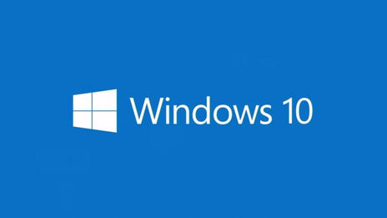
Windows 10
Retour sur la Microsoft //Build 2018
Notes:
5min

Slide 4
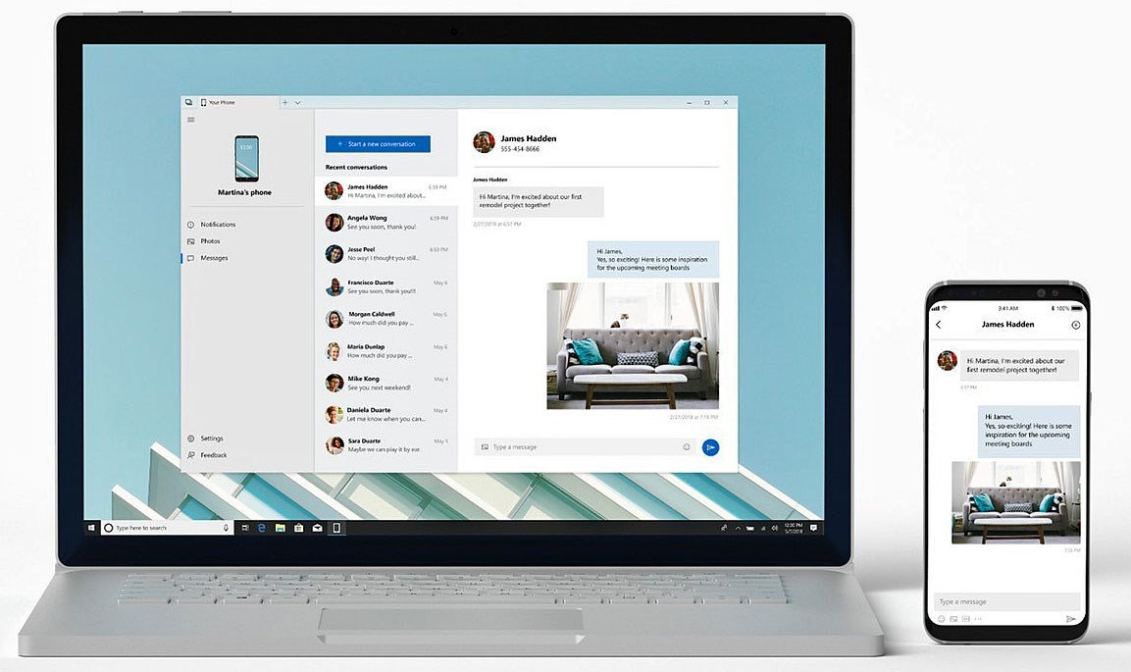
Your Phone app
Windows 10
Sortie fin d’année – Android & iOS
SMS / Photos / Timeline sur PC
Notifications Windows

Slide 5
Progressive Web App
Windows 10
Indexer automatiquement par le Microsoft Store
PWA Builder

Slide 6

Sets & Timeline
Windows 10
DEMO

Slide 7

.NET
Retour sur la Microsoft //Build 2018
Notes:
5min

Slide 8
.NET
.NET
.NET Conf 2018 – 12/13/14 Septembre
.NET Core 2.1 RC 1
.NET Core 3.0 Alpha (.NET Core App Bundler)
C# in the Browser (WebAssembly – Blazor/Ooui)
Notes:
.NET Core 2.1
Span<T>
Windows Compatiblity Pack
EF Core Lazy Loading / GroupBy
ASP.NET Core SignalR
HttpClientFactory
.NET Core 3.0
WPF/WinForms
.NET Core App Bundler

Slide 9
Visual Studio
.NET
Visual Studio 15.7 / VS for Mac 7.5
C# 7.3 (dispo) – C# 8.0 Preview
Visual Studio Live Share
IntelliCode

Slide 10
Xamarin
.NET
Xamarin.Forms 3.0
Hyper-V compatible VMs officielles Android
XAML Standard Preview (Xamarin.Forms 3.1)
Performance (Android Eager Deploy, iOS Full Static Build)

Slide 11
C# 8.0 – Nullable Reference Type
.NET
public class MyClass
{
public string HasValue { get; set; }
public string NotAssigned { get; set; }
public string NullAssigned { get; set; }
public string? NullableNullAssigned { get; set; }
public MyClass() // Warning: NotAssigned is not assigned
{ // and will be null, but is not explicit about it
HasValue = “Mon texte”;
NullAssigned = null; // Warning : NullAssigned is null
// but not explicit about it
NullableNullAssigned = null; // Ok
}
}

Slide 12
C# 8.0 – Nullable Reference Type
.NET
var a = new MyClass();
a.HasValue.Length; // Ok
a.NotAssigned.Length; // Warning: NotAssigned might be null
a.NullableNullAssigned.Length // Warning: NullableNullAssigned is marked as
// nullable

Slide 13
C# 8.0 – Pattern Matching v2
.NET
C# 6 et avant
public string Print(Person v)
{
if (v.GetType() == typeof(Professor))
{
var p = v as Professor;
return "Prof." + v.Name + "-" + v.Type;
}
else if (v.GetType() == typeof(Student))
{
var s = v as Student;
return "Std." + p.Name + "-" + p.Mark;
}
}
public class Person
{
string Name { get; set; }
}
public class Professor : Person
{
string Type { get; set; }
}
public class Student : Person
{
double Mark { get; set; }
}

Slide 14
C# 8.0 – Pattern Matching v2
.NET
C# 7
public string Print(Person v)
{
switch (v)
{
case Professor p:
return "Prof." + p.Name + "-" + p.Type;
case Student s:
return "Std." + s.Name + "-" + v.Mark;
default:
return "Someone";
}
}
public class Person
{
string Name { get; set; }
}
public class Professor : Person
{
string Type { get; set; }
}
public class Student : Person
{
double Mark { get; set; }
}

Slide 15
C# 8.0 – Pattern Matching v2
.NET
C# 8
public string Print(Person v)
{
return v switch
{
Professor { Name = "R.", Type = var t } =>
"Principal. R. -" + t,
Professor p =>
"Prof." + p.Name + "-" + p.Type,
Student s =>
"Std." + s.Name + "-" + s.Mark,
_ =>
"Someone"
};
}
public class Person
{
string Name { get; set; }
}
public class Professor : Person
{
string Type { get; set; }
}
public class Student : Person
{
double Mark { get; set; }
}

Slide 16
C# 8.0 – Ranges
.NET
C# 7 et avant
public void Range()
{
var text = "Hello world";
text.Substring(1, 2); // el
text.Substring(1, text.Length – 2); // ello world
text.Substring(0, text.Length – 2); // Hello worl
text.Substring(1); // ello world
text; // Hello world
}

Slide 17
C# 8.0 – Ranges
.NET
C# 8
public void Range()
{
var text = "Hello world";
text.Substring(1..3); // el
text.Substring(1..^1); // ello world
text.Substring(..^1); // Hello worl
text.Substring(1..); // ello world
text.Substring(..); // Hello world
}

Slide 18
Visual Studio Live Share & IntelliCode
.NET
DEMO

Slide 19

Azure Artificial Intelligence
Retour sur la Microsoft //Build 2018
Notes:
5min

Slide 20
Services
Azure – IA
Azure Cosmos DB
Azure SignalR Service
Microsoft Graph
BotBuilder v3 / Bot Framework Emulator Preview

Slide 21
Machine Learning
Azure – IA
WinML (Format ONNX) / Embarqué dans IoT
Drones DJI
Camera
ML.NET
Cognitive Services améliorés (Text Analysis, QnAMaker, Luis, etc.)

Slide 22
Snip Insights
Azure – AI
DEMO
https://aka.ms/SampleSnipInsight

Slide 23
Bot & IA – Litware demos
Azure – AI
DEMO
https://retail.litwaredemos.com/en-us/
https://retail.litwaredemos.com/en-us/kiosk
https://retail.litwaredemos.com/en-us/associates

Slide 24
Adaptive Cards in Outlook
Azure – AI
DEMO

Slide 25
En savoir plus
Retour sur la Microsoft //Build 2018
Replays //Build 2018 : https://channel9.msdn.com/Events/Build/2018
Nos récapitulatifs en direct de la //Build https://blog.infeeny.com/category/applications-digital/evt-microsoft-build-2018/

